Slide 1
UNIT – V: Application Layer
Domain Name Space (DNS)
DDNS
TELNET
EMAIL
File Transfer Protocol (FTP)
WWW
HTTP
SNMP
Firewalls

Slide 2
Domain Name Space or Domain Name System
In Application Layer DNS is a host name to IP address translation service. DNS is a distributed database implemented in a hierarchy of name servers. It is an application layer protocol for message exchange between clients and servers.
Requirement
Every host is identified by the IP address but remembering numbers is very difficult for the people and also the IP addresses are not static therefore a mapping is required to change the domain name to IP address. So DNS is used to convert the domain name of the websites to their numerical IP address.

Slide 3
Domain : There are various kinds of DOMAIN :
Generic domain :The generic domains define registered hosts according to their generic behavior. Each node in the tree defines a domain, which is an index to the domain name space database.
Example: .com(commercial) .edu(educational) .mil(military) .org(non profit organization) .net(similar to commercial) all these are generic domain.
Country domain: The country domains section uses two-character country abbreviations
example : .us (United States), .in(India)
Inverse domain: if we want to know what is the domain name of the website. we have to type nslookup www.geeksforgeeks.org.

Slide 4
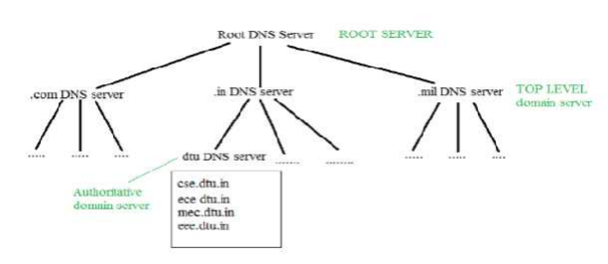
Hierarchy of Name Servers

Slide 5
Root name servers – It is contacted by name servers that can not resolve the name. It contacts authoritative name server if name mapping is not known. It then gets the mapping and return the IP address to the host.
Top level server – It is responsible for com, org, edu etc and all top level country domains like uk, fr, ca, in etc. They have info about authoritative domain servers and know names and IP addresses of each authoritative name server for the second level domains.
Authoritative name servers This is organization’s DNS server, providing authoritative hostName to IP mapping for organization servers. It can be maintained by organization or service provider. In order to reach cse.dtu.in we have to ask the root DNS server, then it will point out to the top level domain server and then to authoritative domain name server which actually contains the IP address. So the authoritative domain server will return the associative ip address.

Slide 6
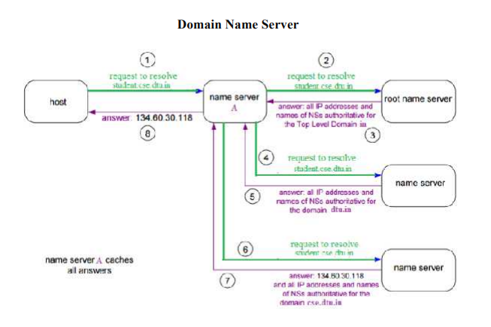

Slide 7
The client machine sends a request to the local name server, which , if root does not find the address in its database, sends a request to the root name server , which in turn, will route the query to an intermediate or authoritative name server. The root name server can also contain some hostName to IP address mappings . The intermediate name server always knows who the authoritative name server is. So finally the IP address is returned to the local name server which in turn returns the IP address to the host.

Slide 8
Dynamic Domain Name Space or System (DDNS)
When DNS (Domain Name System) was designed, nobody expected that there would be so many address changes such as adding a new host, removing a host, or changing an IP address. When there is a change, the change must be made to the DNS master file which needs a lot of manual updating and it must be updated dynamically.
DDNS automatically updates the name server in the Domain Name Server (DNS), often in real-time, with the active DDNS configuration of its configured hostnames, addresses, or other information. In DDNS, when a binding between a name and an address is determined, the information is sent, usually by DHCP (Dynamic Host Configuration Protocol) to a primary DNS server.

Slide 9
TELNET:
TELNET stands for TErminaL NETwork. It is a type of protocol that enables one computer to connect to local computer. It is a used as a standard TCP/IP protocol for virtual terminal service which is given by ISO.
Computer which starts connection known as the local computer. Computer which is being connected to i.e. which accepts the connection known as remote computer.
When the connection is established between local and remote computer.
During telnet operation whatever that is performing on the remote computer will be displayed by local computer.
Telnet operates on client/server principle. Local computer uses telnet client program and the remote computers uses telnet server program.

Slide 10
Electronic Mail (Email)
Electronic Mail (e-mail) is one of most widely used services of Internet.
This service allows an Internet user to send a message in formatted manner (mail) to the other Internet user in any part of world.
Message in mail not only contain text, but it also contains images, audio and videos data.
The person who is sending mail is called sender and person who receives mail is called recipient. It is just like postal mail service.
Components of E-Mail System:
User Agent (UA)
The UA is normally a program which is used to send and receive mail. Sometimes, it is called as mail reader.

Slide 11
Message Transfer Agent (MTA) :MTA is actually responsible for transfer of mail from one system to another. To send a mail, a system must have client MTA and system MTA. It transfer mail to mailboxes of recipients if they are connected in the same machine
Mail Box: It is a file on local hard drive to collect mails. Delivered mails are present in this file. The user can read it delete it according to his/her requirement. To use e-mail system each user must have a mailbox . Access to mailbox is only to owner of mailbox.
Spool file:This file contains mails that are to be sent. User agent appends outgoing mails in this file using SMTP

Slide 12
Services provided by E-mail system :
Composition – A user agent helps the user compose the e-mail message to be sent out.
Reading Messages – The second duty of the user agent is to read the incoming messages.
Replying to Messages – After reading a message, a user can use the user agent to reply to a message.
Forwarding Messages – Replying is defined as sending a message to the sender or recipients of the copy.
Handling Mailboxes – A user agent normally creates two mailboxes: an inbox and an outbox.

Slide 13
Transfer – Transfer means sending procedure of mail i.e. from the sender to recipient.
Reporting – Reporting refers to confirmation for delivery of mail. It help user to check whether their mail is delivered, lost or rejected.
Disposition – This step concern with recipient that what will recipient do after receiving mail i.e save mail, delete before reading or delete after reading.

Slide 14
Multipurpose Internet Mail Extension (MIME) Protocol
Multipurpose Internet Mail Extension (MIME) is a standard which was proposed by Bell Communications in 1991 in order to expand limited capabilities of email.
MIME is a kind of add on or a supplementary protocol which allows non-ASCII data to be sent through SMTP.
It allows the users to exchange different kinds of data files on the Internet: audio, video, images, application programs as well.
Features of MIME
It is able to send multiple attachments with a single message.
Unlimited message length.
Binary attachments (executables, images, audio, or video files) which may be divided if needed.
MIME provided support for varying content types and multi-part messages.

Slide 15
MIME Header:
It is added to the original e-mail header section to define transformation. There are five headers which we add to the original header:
1. MIME Version – Defines version of MIME protocol. It must have the parameter Value 1.0, which indicates that message is formatted using MIME.
2. Content Type – Type of data used in the body of message. They are of different types like text data (plain, HTML), audio content or video content.
3. Content Type Encoding – It defines the method used for encoding the message. Like 7-bit encoding, 8-bit encoding, etc.
4. Content Id – It is used for uniquely identifying the message.
5. Content description – It defines whether the body is actually image, video or audio

Slide 16
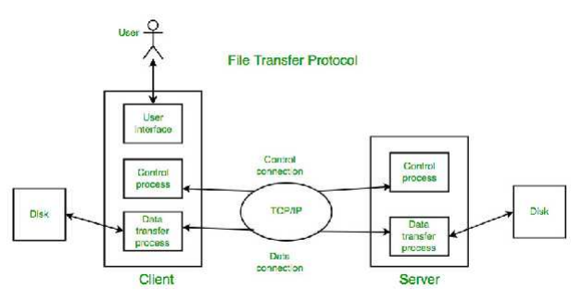
File Transfer Protocol (FTP)
File Transfer Protocol(FTP) is an application layer protocol which moves files between local and remote file systems. It runs on the top of TCP, like HTTP. To transfer a file, 2 TCP connections are used by FTP in parallel: control connection and data connection.

Slide 17
Control Connection
For sending control information like user identification, password, commands to change the remote directory, commands to retrieve and store files, etc.
Data Connection
For sending the actual file, FTP makes use of data connection.
FTP Session
When a FTP session is started between a client and a server, the client initiates a control TCP connection with the server side. The client sends control information over this. When the server receives this, it initiates a data connection to the client side. Only one file can be sent over one data connection. But the control connection remains active throughout the user session.

Slide 18
World Wide Web (WWW)
The World Wide Web abbreviated as WWW and commonly known as the web. The WWW was initiated by CERN (European library for Nuclear Research) in 1989.
System Architecture:
From user’s point of view, the web consists of a vast, worldwide connection of documents or web pages. Each page may contain links to other pages anywhere in the world. The pages can be retrieved and viewed by using browsers of which internet explorer, Netscape Navigator, Google, Chrome, etc are the popular ones. The browser fetches the page requested interprets the text and formatting commands on it, and displays the page, properly formatted, on the screen. The basic model of how the web works is shown in figure below. Here the browser is displaying a web page on the client machine. When the user clicks on a line of text that is linked to a page on the abd.com server, the browser follows the hyperlink by sending a message to the abd.com server asking it for the page

Slide 19
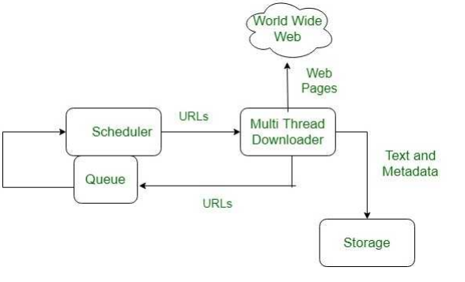
Here the browser displaying web page on the client machine when the user clicks on a line of text that is linked to a page on abd.com, the browser follows the hyperlink by sending a message to abd.com server asking it for the page.

Slide 20
Features of WWW:
• HyperText Information System
• Cross-Platform
• Distributed
• Open Standards and Open Source
• Uses Web Browsers to provide a single interface for many services
• Dynamic, Interactive and Evolving.
• “Web 2.0”

Slide 21
Components of Web There are 3 components of web:
Uniform Resource Locator (URL): serves as system for resources on web.
HyperText Transfer Protocol (HTTP): specifies communication of browser and server.
Hyper Text Markup Language (HTML): defines structure, organisation and content of webpage.

